Slide 1

Data Warehousing and Business Intelligence Design – Nestle
Course : MIS 636, Fall 2016
Abiola Anderson
Ajinkya Bobade
Ankita Sawant
Anuradha Ramprasad
Vandna Yadav

Slide 2
Nestle
Leading Nutrition, Health and Wellness Company
Have been in business for over 150 years
Wide range of products and spans over 194 countries
World’s most profitable corporation in 2011
29 of their Brands have more than $1 Billion annual revenue

Slide 3

Why DW/BI ?
To increase its profitability and extend its worldwide coverage.
Improve distribution and logistics, directly impacting business profitability.
Anticipate their customer's needs
Improve sales and assortment by region and by specific customer.
Ability to scale as the business grows, maintaining full parallelism without limitation in terms of anticipated volume.

Slide 4
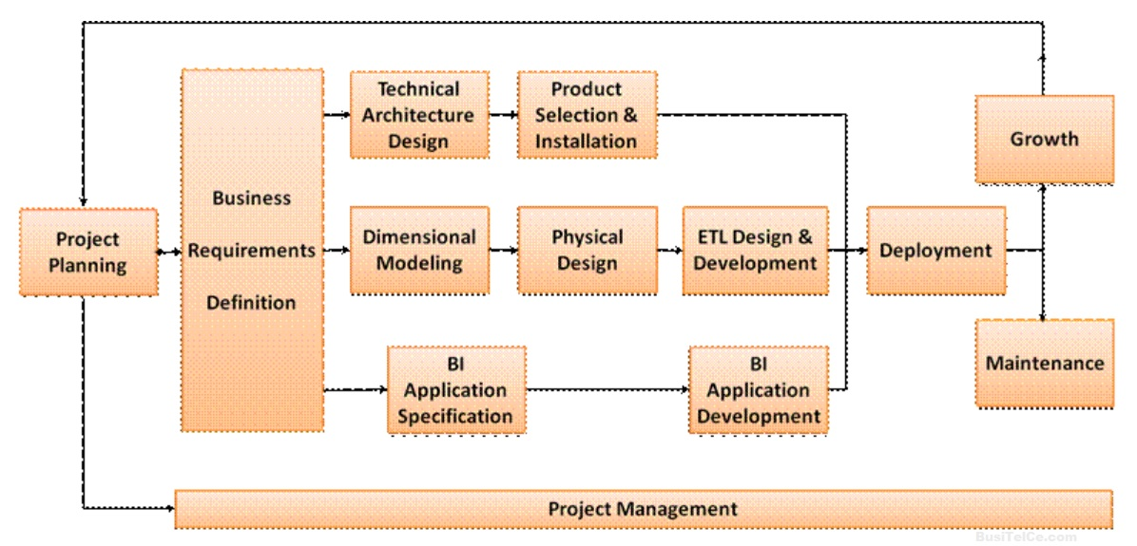
The Business Dimensional Life Cycle
Notes:
Program/Project Planning and Management:
The first box on the roadmap focuses on getting the program/project launched, including scoping, justification and staffing.
Business Requirements:
This unit involves collecting Requirements that determine the key factors impacting the business. Then detailed requirements are gathered for the first iteration of the DW/BI system development. Three concurrent Lifecycle tracks follow the business requirements definition.
Technology Track:
The technology track begins with system architecture design to establish a shopping list of needed capabilities, followed by the selection and installation of products satisfying those architectural needs.
Data Track:
The data track begins with the design of a target dimensional model to address the business requirements, while considering the underlying data realities. Dimensional models can be instantiated in relational databases, referred to as star schemas, or multidimensional databases, known as OLAP cubes. The dimensional model is converted into a physical design where performance tuning strategies are considered, then the ETL system design and development challenges are tackled.
Business Intelligence Track:
While some project members are immersed in the technology and data, others focus on identifying and constructing a broad range of BI applications, including standardized reports, parameterized queries, dashboards, scorecards, analytic models, data mining applications, along with the associated navigational interfaces.
Deployment, Maintenance, and Growth:
The three Lifecycle tracks converge at deployment, bringing together the technology, data and BI applications. The deployed iteration enters a maintenance phase, while growth is addressed by the arrow back to project planning for the next iteration of the DW/BI system. Thus DW/BI system is a long term process and thus the DW/BI professionals must continuously straddle the business’s requirements and the underlying realities of the source data, technology, and related resources
Program/Project Planning and Management:
The first box on the roadmap focuses on getting the program/project launched, including scoping, justification and staffing.
Business Requirements:
This unit involves collecting Requirements that determine the key factors impacting the business. Then detailed requirements are gathered for the first iteration of the DW/BI system development. Three concurrent Lifecycle tracks follow the business requirements definition.
Technology Track:
The technology track begins with system architecture design to establish a shopping list of needed capabilities, followed by the selection and installation of products satisfying those architectural needs.
Data Track:
The data track begins with the design of a target dimensional model to address the business requirements, while considering the underlying data realities. Dimensional models can be instantiated in relational databases, referred to as star schemas, or multidimensional databases, known as OLAP cubes. The dimensional model is converted into a physical design where performance tuning strategies are considered, then the ETL system design and development challenges are tackled.
Business Intelligence Track:
While some project members are immersed in the technology and data, others focus on identifying and constructing a broad range of BI applications, including standardized reports, parameterized queries, dashboards, scorecards, analytic models, data mining applications, along with the associated navigational interfaces.
Deployment, Maintenance, and Growth:
The three Lifecycle tracks converge at deployment, bringing together the technology, data and BI applications. The deployed iteration enters a maintenance phase, while growth is addressed by the arrow back to project planning for the next iteration of the DW/BI system. Thus DW/BI system is a long term process and thus the DW/BI professionals must continuously straddle the business’s requirements and the underlying realities of the source data, technology, and related resources

Slide 5
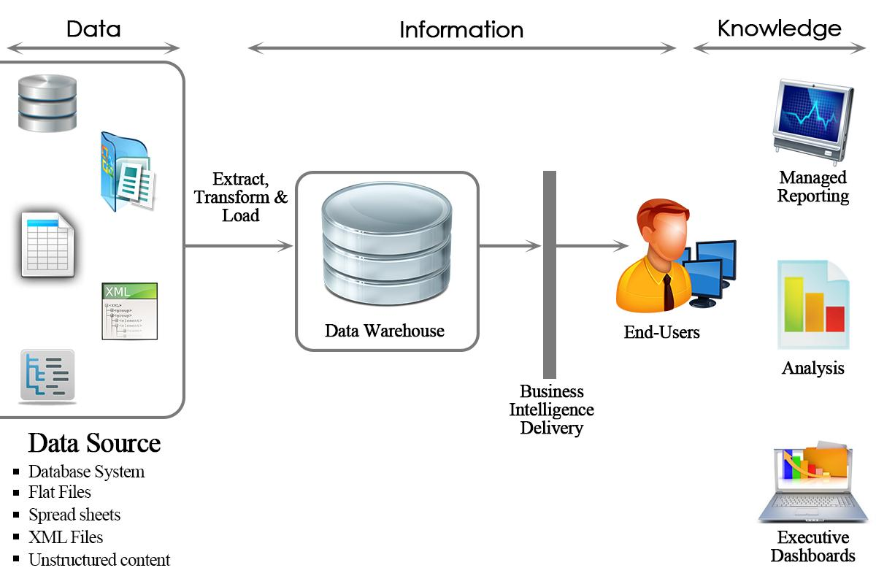
DW/BI Architecture

Slide 6

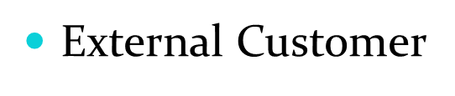
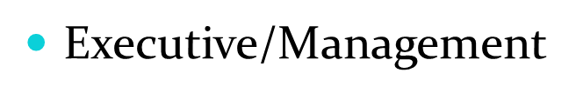
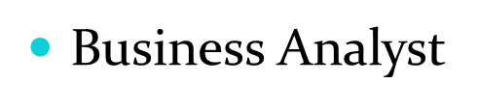
Users and Task Analysis
Lowest level entry point with limited data on a specific business process
Access to data details and create simple reports
Operational Reports
Lower level entry point with both summary and drill down capability
Hybrid persuasive exploratory – informative explanatory visualization
High level entry point with summary data and drill down capability
Interested in summaries rather than day to day details.
Advanced Ad hoc do it yourself, Reporting/Analysis
High level entry point with summary data, drill down and drill across capabilities
advance ad hoc query
Advanced Ad hoc do it yourself, Reporting/Analysis

Slide 7
High Level DW Bus Matrix
High Level Enterprise Data Warehouse Bus Matrix
 | Date | Product | Supplier | Warehouse | Outlet | Promotion | Customer | Employee
Sales Transaction | X | X | X |  | X | X | X | X
Order Management | X | X | X |  | X | X | X | X
Delivery Process | X | X | X | X | X |  |  | X
Return Policy | X | X |  | X | X | X | X | X
Conformed Dimension
Business Processes
Business Processes
Notes:
The bus matrix is the essential tool for designing and communicating the bus architecture. The rows of the matrix are business processes and the columns are dimensions. The shaded cells of the matrix indicate whether a dimension is associated with a given business process.The design team scans each row to test whether a candidate dimension is well-deﬁned for the business process and also scans each column to see where a dimension should be conformed across multiple business processes. Besides the technical design considerations, the bus matrix is used as input to prioritize DW/BI projects with business management as teams should implement one row of the matrix at a time.

Slide 8
Opportunity Matrix
High Level Enterprise Data Warehouse Bus Matrix
Organization /Work Groups
Business
Functions
 | Marketing | Finance | Customer Service | Inventory Management | Omni channel service | Employees | Shipping
Sales Transaction | X | X | X |  | X | X | X
Order Management |  | X | X | X | X | X | X
Delivery Process |  |  |  | X |  | X | X
Return Policy |  | X | X | X | X | X | X
Business Process
Business Processes
Notes:
After the bus matrix rows have been identiﬁed, you can draft a different matrix by replacing the dimension columns with business functions, such as marketing, sales, and ﬁnance, and then shading the matrix cells to indicate which business functions are interested in which business process rows. The opportunity matrix helps identify which business groups should be invited to the collaborative design sessions for each process-centric row.

Slide 9
Prioritization Grid
High
BP4
BP1
BP3
BP2
Potential
Business Impact
Low
Low
High
Feasibility
Notes:
The Prioritization Matrix facilitates the discussion and debate between the Business and IT stakeholders in identifying the “right” use cases to start an initiative.Focusing the Prioritization Matrix process on a key business initiative – such as increasing same store sales, minimizing financial risk, optimizing market spend – is critical.as it provides the foundation upon which the business value and implementation feasibility discussion and subsequent placement on the matrix discussion can occur. The targeted business initiative provides the key performance indicators the critical success factors

Slide 10
Designing a dimensional model
The four decisions made during design of a dimensional model are:
Select the business process.
This process will be the source of your metrics or measurements. Eg. Sales Transaction
Declare the grain.
Grain of a fact table = the meaning of one fact table row. Determines the maximum level of detail of the warehouse. E.g. Per month, region
Identify the dimensions.
Define how to analyze the fact information and should be as descriptive as possible. Should confirm to the grain defined in step 2. E.g. Date, Product, Supplier , Customer
Identify the facts.
Identify the measurements (metrics or facts). The facts should be numeric and should confirm to the grain defined in step 2. E.g. Products sold

Slide 11
Detailed Bus Matrix
Dimensions
Business process | Fact Tables | Granularity | Fact | Date | Product | Supplier | Warehouse | Outlet | Promotion | Customer | Employee
Sales Transaction | Sales_fact | per item | Products sold | X | X | X |  | X | X | X | X
 | Sales_forecast | per item | Sales forecasted | X | X | X |  | X | X | X | X
 | Vendor_detail | per vendor item | Vendor details | X | X | X |  | X |  |  | X
Order Management | Order_billling | per order | Amount earned | X | X |  |  | X | X | X | X
 | Store_inventory | per order | Products available | X | X |  |  | X | X | X | X
 | Promo_tracking | per item | Items being promoted | X | X |  |  |  | X | X | X
 | Freq_shoppers | per order | Customers earned | X | X |  |  | X | X | X | X
Delivery Process | Ship_product | per item | Products shipped | X | X | X | X | X |  |  | X
 | Deliver_product | per item | Products delivered | X | X | X | X | X |  |  | X
Return Policy | Store_return | per item | Products returned | X | X |  | X | X |  | X | X
 | Vendor_return | per item | Products returned | X | X | X | X | X |  |  | X
 | Online_return | per item | Products returned | X | X |  | X | X |  | X | X
Notes:
Demonstrate the confirmed dimension here

Slide 12
Conformed Dimensions
In data warehousing, a conformed dimension is a dimension that has the same meaning to every fact with which it relates. Conformed dimensions allow facts and measures to be categorized and described in the same way across multiple facts, ensuring consistent reporting across the enterprise.
In our project conformed dimensions are:
Region
Store
Product
Sale_Order
Inventory

Slide 13
Conformed Dimensions
Sales_fact
Sales_Order
Sales_Invoice_Id(PK)
Product_id
Quantity
Price
Date
Store_Id
Region
Region_Id(PK)
Region_Name
Region_Type
City
Country
Store
Store_Id(PK)
Store_Name
Region_Id
City
Country
Inventory
Inventory_Id (PK)
Product_Id
Product_Qty
Warehouse_Location
Product
Product_Id(PK)
Band_Name
Brand_Desc
Product_Category_Id
Product_Dept
Store_acc_fact
Notes:
There are two fact tables and for both of them the conformed dimensions are Region, Store, Sales_Order, Inventory and Product.

Slide 14
High Level Architecture
Product
Inventory
Store
Sales_fact
Order
Region
Date
Price
Promotion
Notes:
This is the High level architecture of sales_fact table, other than the five conformed dimensions we have added 3 more dimensions to it.

Slide 15
Logical Fact Table Diagram
Date
Product
Sales_Transaction Fact Table
Grain:
Sales_Transaction
Product Brands
Region
Order
Country
Store
Inventory
Promotion
Price
Promotion
Group
Notes:
This is the Logical fact table diagram, over here we can add further dimensions to the already dimensions for example: Product Brands to Product, Country to Region and Promotion to Promotion Group.

Slide 16
Detailed Fact Table – Sales Transaction
Sale transaction line item Fact Table
Region_ID
Store_ID
Order_No.
Supplier_ID
Item_ID
Invoice
Date
Promo_ID
Sales_unit
- Dimension Keys
- FK
Dimensions are the foundation of the fact table, and is where the data for the fact table is collected.
The grain of a fact table represents the most atomic level by which the facts may be defined.

Slide 17
Sales Transaction Schema
Date
Date_Id (PK)
Sale_Day
Sale_Month
Sale_Year
Quarter
Holiday
Product
Product_Id(PK)
Band_Name
Brand_Desc
Product_Category_Id
Product_Dept
Sales_Transactions_ Fact_Table
Date_Id (FK)
Product_Id (FK)
Store_Id (FK)
Region_Id (FK)
Price_Id (FK)
Promotion_Group_Key
Inventory_Id (FK)
Sales_Invoice_Id(FK)
Quantity Sold
Dollar Sales
Store
Store_Id(PK)
Store_Name
Region_Id
City
Country
Price
Price_Id(PK)
Product_Id
Product_Price
Unit Rate
Currency
Region
Region_Id(PK)
Region_Name
Region_Type
City
Country
Sales_Order
Sales_Invoice_Id(PK)
Product_id
Quantity
Price
Date
Store_Id
Inventory
Inventory_Id (PK)
Product_Id
Product_Qty
Warehouse_Location
Promotion
Promotion_Key (PK)
Promotion_Rate
Promotion_Type
Coupon Date
Expiration
Notes:
The star schema is the simplest style of data mart schema and is the approach most widely used to develop data warehouses and dimensional data marts. The star schema consists of one or more fact tables referencing any number of dimension tables.This is the detailed fact table of sales transaction, over here we can see all the primary keys of the added dimension table, are included

Slide 18
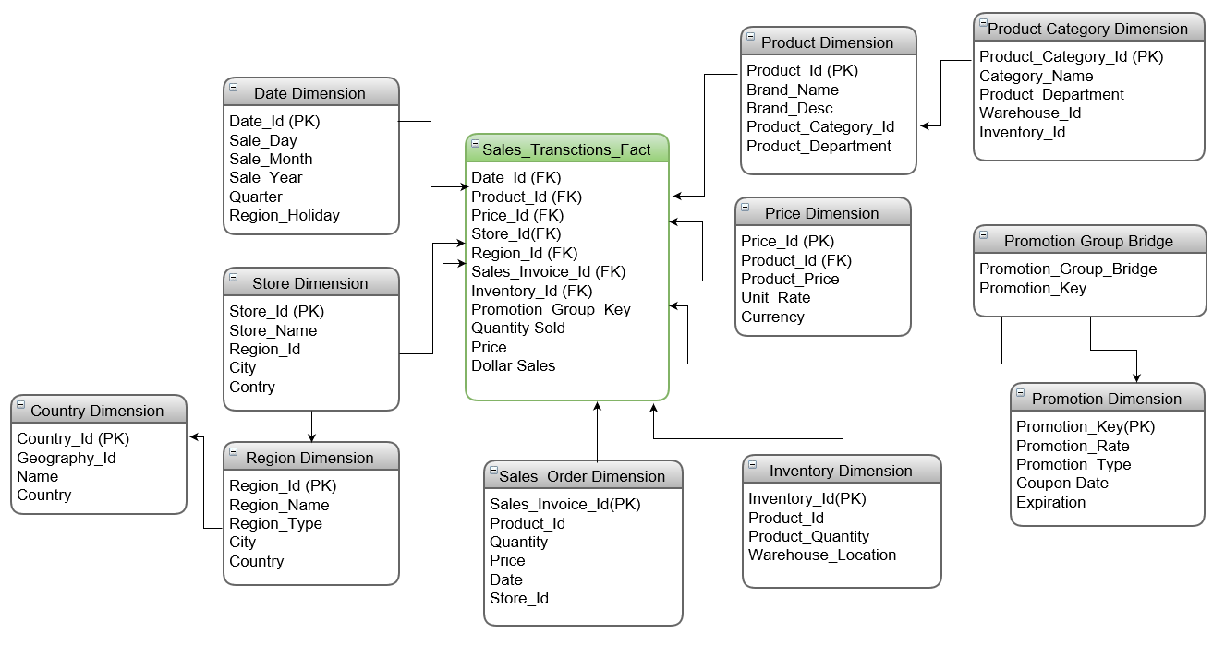
Detailed Transaction Schema
Notes:
A snowflake schema is a logical arrangement of tables in a multidimensional database such that the entity relationship diagram resembles a snowflake shape. The snowflake schema is represented by centralized fact tables which are connected to multiple dimensions. Over here we can see the Country Dimension is added with the region dimension, promotion dimension are added to the promotion Group Bridge, and Product Category Dimension ia added with product dimension.

Slide 19
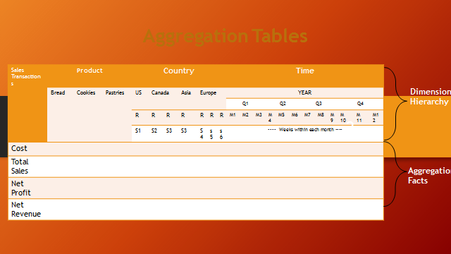
Notes:
This model allows for an increase in efficiency through system design instead of the exclusive method of hardware and Software…
The Common grouping levels help to assess the Platform for the Company’s Aggregation Facts.
This helps with Capacity planning by assessing the primary business requests which is used to figure out where some of the more successful items are sold.

Slide 20
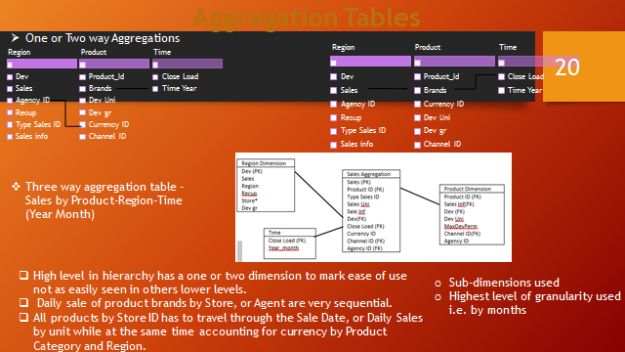
Notes:
The above table shows some of the more able aggregate paths and frequency aspects,
The number of possible values in each attribute (Cardinality)

Slide 21
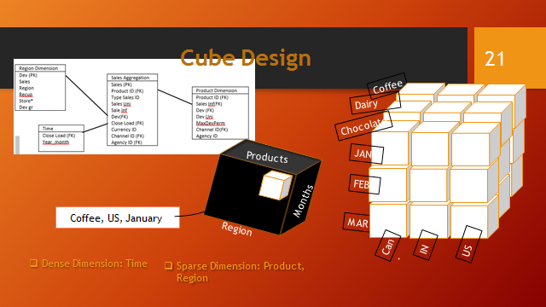
Notes:
In our design; not all the Products are sold in all the country/region, so they’re considered as Sparse dimensions. However there will be at least some product sale occur in every day, week, month, quarter, year etc. within certain country/region, so they’re considered as Dense dimensions.

Slide 22
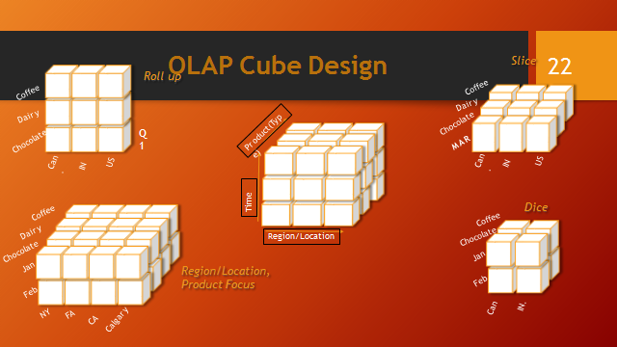
Notes:
This is a more in depth view of the Aggregation structure making it easier to understand how some of the calculation are made.
With a more expansive look at the data infrastructure it makes it easier to indexes

Slide 23
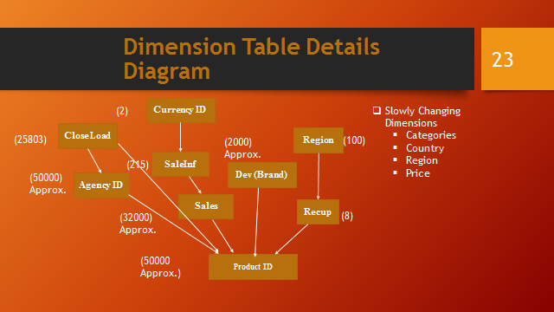
Notes:
Each dimension can hold a detail diagram and in this example a product ID dimension is used to show its individual attributes, approximate cardinality and required hierarchy and relationship between dimensions. This allows the hypothetical
And the changing dimensions to actually change

Slide 24
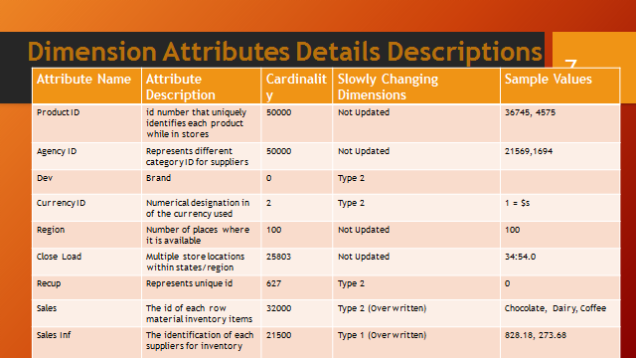
Notes:
Slow Changing Dimensions with Type 1are overwritten as no history or record is kept.
Slow Changing Dimensions with Type 2 will require new row added with current or indicator I needed for history record for future reference.

Slide 25
Transformation Rules
Rule Type | Description
Extraction/Move | Required Products, Sales and regional distributions data will be extracted from the source-to-target tables on daily bases for further data cleansing.
Cleansing | The data that violates business rules will be changed to conform target system rules.
Transformation | The source table values will be converted in desired format for target tables. E.g. source product keys will be converted to dimension tables product keys.
Derivation | New data columns will be created from existing source data by calculations, program logic or look ups. E.g. Calculate profits from incomes and expenses, sale-date column in YYYYMM format
Summarizations / Aggregations | The same arithmetic computation rules will be applied in target tables. Values will be summarized to obtain total figures which will be calculated and stored at multiple levels in multidimensional fact tables.
Default / Drop | If the source tables contains null values then default values will be used when populating data in target tables. Only required data will be moved to target systems with same values.

Slide 26
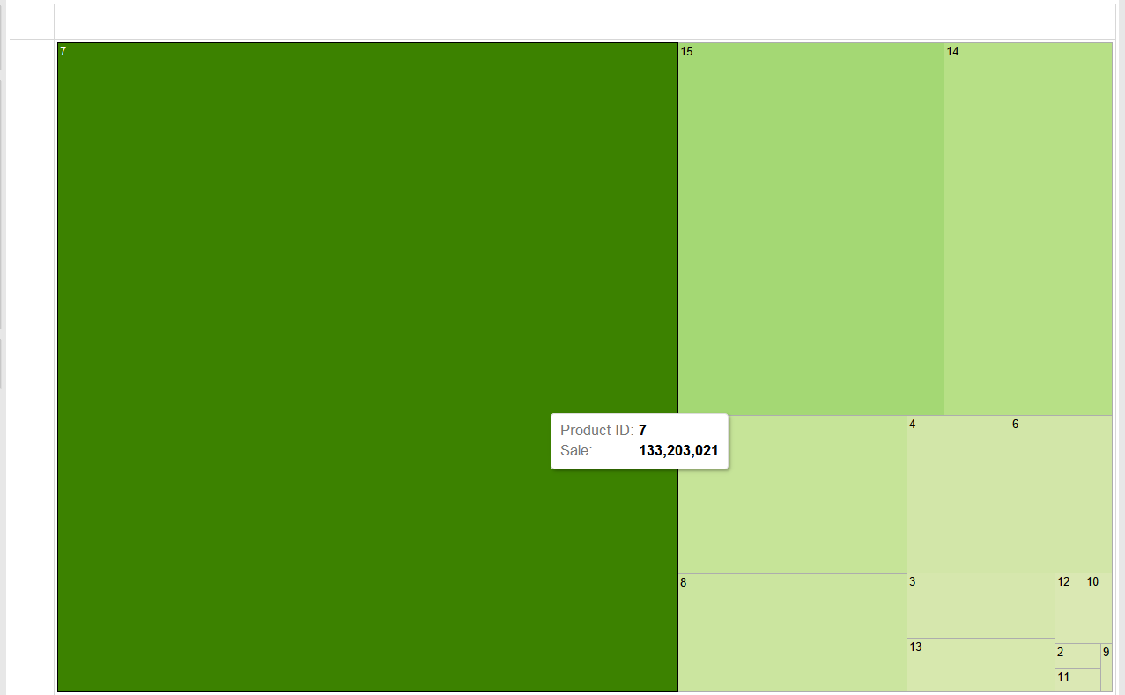
Dashboard Sample—sales by product
Heatmap for Sales per product
Notes:
A heat map (or heatmap) is a graphical representation of data where the individual values contained in a matrix are represented as colors.

Slide 27
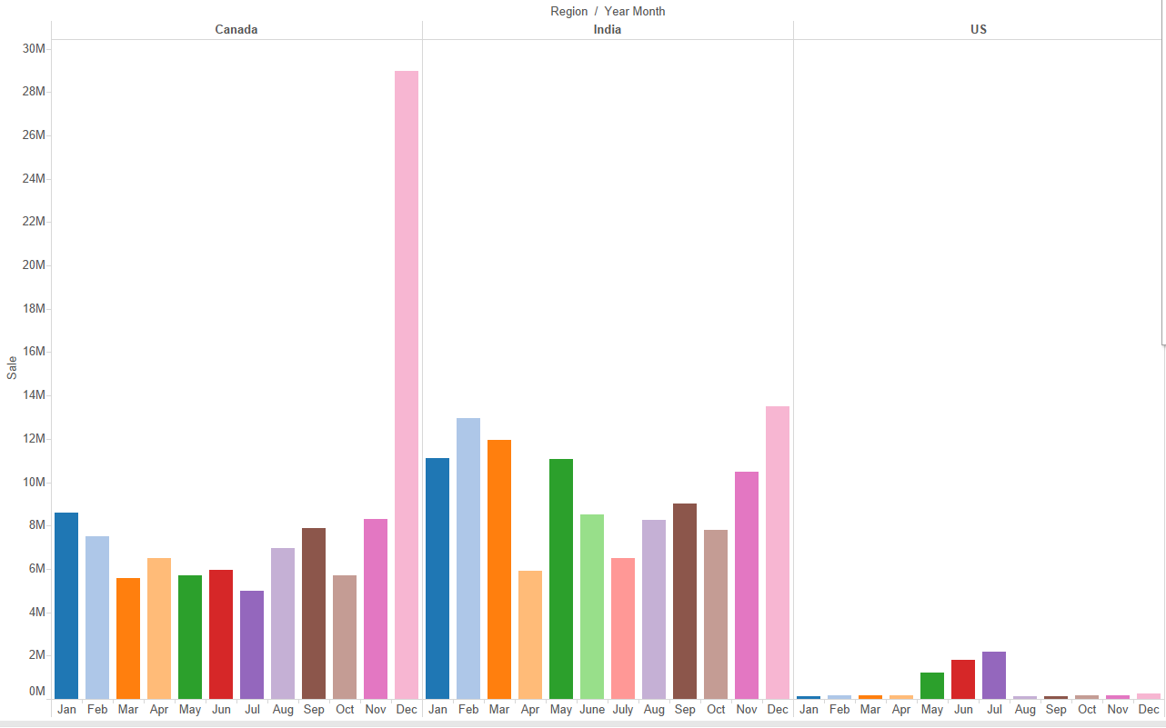
Monthly sales of different regions
Monthly sales for different regions

Slide 28
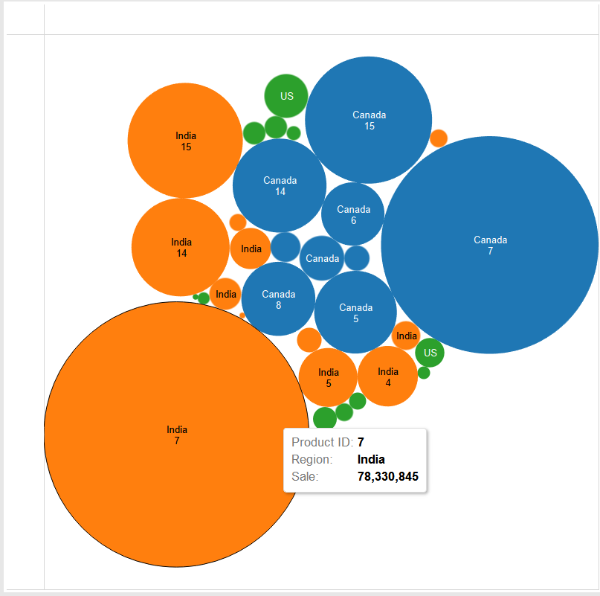
Sales by Product for each region
Graph of sales vs product for each region

Slide 29
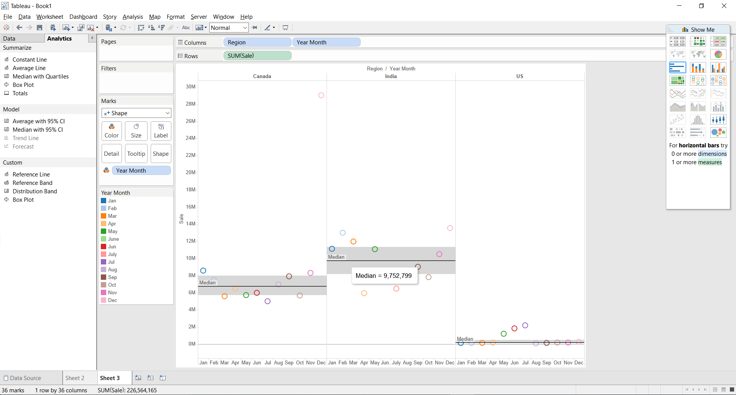
BI Portal- Analyst with median sales figures
Analyst with median sales figures
Notes:
Median is value or quantity lying at the midpoint of a frequency distribution

Slide 30
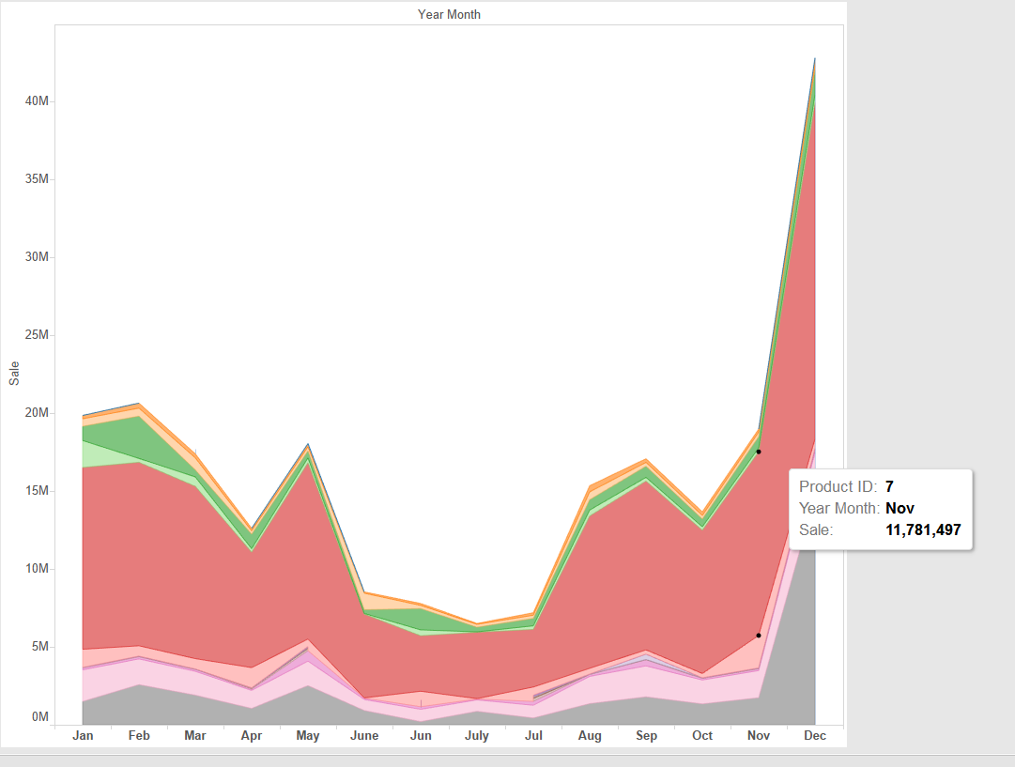
BI Analytics– Sales per month for each product
Sales per month for each product

Slide 31

Thank you

